Slide 1
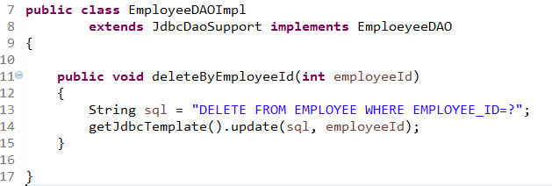
Use JdbcTemplate To Execute Delete Statement With Parameter

